Slide 1
Kick-off Meeting
July 20, 2020
Support to the development of an Asset Management System and Asset Information System in the railway sector, Montenegro
Contract# EIB-MNE-RIOM-SER-SL-2019-A1

Slide 2
Kick-off Meeting Agenda
14.00 – 14.30 Welcoming Statements and Foreword / Uvodna riječ
Representative of the Railway Infrastructure of Montenegro JSC – Podgorica (RIoM) / Predstavnik Željezničke Infrastrukture Crne Gore AD – Podgorica (ZICG)
Representative of the Ministry of Transport and Maritime Affairs / Predstavnik Ministarstva saobraćaja i pomorstva
Representative of KPMG d.o.o. Beograd / Predstavnik KPMG d.o.o. Beograd
14.30 – 15.00 Presentation of the Project / Prezentacija projekta
15.00 – 15.30 Inception Phase – Provisional Work Plan / Početna faza – Okviran vremenski plan
15.30 – 16.00 Open discussion / Otvorena diskusija
* Meeting minutes will be provided by the Project / Zapisnik će biti prosleđen učesnicima sastanka

Slide 3
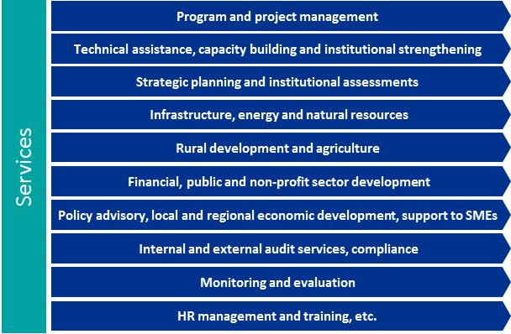
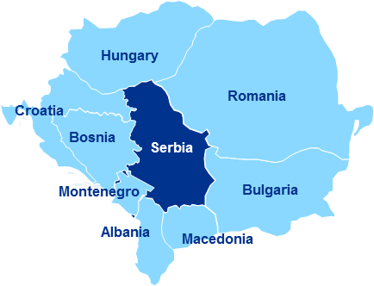
About KPMG
KPMG’s global network of professional firms provides audit, advisory and tax services in 153 countries around the world, currently employing 207,000 people.
EU level – KPMG EU Office as central body for coordinating with respect to EU clients. Shared centers of excellence and infrastructure, ensuring a high level of client service throughout the region.
KPMG d.o.o. Beograd (KPMG Serbia) – leading professional services firm in Serbia providing audit, advisory and tax services in the country since 1996, with more than 250 employees.
KPMG Public Sector Consulting / Development Cooperation
delivering highly-tailored local solutions, based on key insights gained from our firms’ work with similar public and private sector organizations around the world.
our clients represent the broad spectrum of governments and their bodies, development community players, including development assistance recipients, governmental and non-governmental organizations, corporations, private foundations, United Nations agencies, international financial institutions, local and regional governments and European Commission.

Slide 4
Key Highlights about the Project – Objective/purpose
Overall Objective
To facilitate the potential for economic growth in the country and in the region by:
Enhancing railway infrastructure development and maintenance in Montenegro;
Increasing the competitiveness and level of service of railway transport in Montenegro, thereby increasing the potential for a transport modal shift from road to rail.
Purpose
To design an AMS and AIS tailored to the identified needs of ŽICG, including:
proposed adjustments to management structure and/or business procedures;
proposed related changes to staffing requirements and their training;
hardware and software requirements.

Slide 5
Key Highlights about the Project - Results
An agreed proposal for an AMS and AIS within ŽICG that is compatible with the scope and complexity of railway assets and operations in Montenegro;
a proposal for adjusting ŽICG’s management structure to accommodate the introduction of business procedures, an AMS and an AIS;
a proposal for developing the human resources required to manage and implement the proposed AMS and AIS;
a comprehensive assessment of the hardware and software required to establish the proposed AIS;
preparation of a procurement plan and tender dossiers for the works, goods and services deemed necessary to implement and sustain the AMS and AIS.

Slide 6
Key Highlights about the Project – Project Team, duration
Key Expert 1: Team Leader / AMS Expert
Mr. Vasko Vassilev
Key Expert 2: Information Technology Specialist
Mr. Plamen Petkov
Key Expert 3: Railway operations expert
Mr. Predrag Jovanović
Project Management Team
Project Director – Mr. Aleksandar Bućić
Project Manager – Ms. Aleksandra Trbojević
Duration, resources
10 months
280 working days for Key experts, 80 working days for Non-key experts

Slide 7
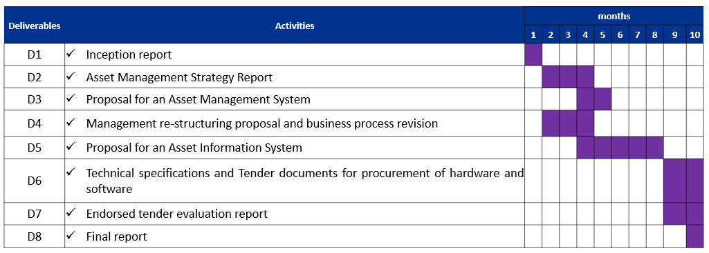
Key Highlights about the Project – Provisional Workplan

Slide 8
Key Highlights about the Project – Inception Phase provisional Workplan
Duration: 1 month from the Kick-off meeting
Activities during the Inception phase:
Mobilization of expert staff resources, establishment of logistical arrangements
Coordination meeting of project team with ZICG
Consultative meeting with the sector working with asset management
Gap analysis of asset management data
Preparation of presentation of examples of good practice in EU Member states (organization of management systems and IT systems)
Identification of stakeholders important for achieving the project objectives
Assessment of the management structure, business processes and human resources of ZICG and its relationship with other institutions within the railway sector
Inception report
Inception phase workshop (Inception report and EU Member states good practices)

Slide 9
KPMG Relevant Contacts
Aleksandar Bućić, Project Director
Partner, KPMG, Public Sector and Development Cooperation
abucic@kpmg.com
Mr. Vasko Vassilev, Team leader, AMS expert
KPMG d.o.o. Beograd
Kraljice Natalije 11
11000 Belgrade
Republic of Serbia
Tel: + 381 (11) 20 50 500
Fax: + 381 (11) 20 50 550
www.kpmg.rs

Slide 10
Thank you

Slide 11
kpmg.com/socialmedia
kpmg.com/app
The information contained herein is of a general nature and is not intended to address the circumstances of any particular individual or entity. Although we endeavor to provide accurate and timely information, there can be no guarantee that such information is accurate as of the date it is received or that it will continue to be accurate in the future. No one should act on such information without appropriate professional advice after a thorough examination of the particular situation.
© 2020 KPMG d.o.o. Beograd, a Serbian limited liability company and a member firm of the KPMG network of independent member firms affiliated with KPMG International Cooperative (“KPMG International”), a Swiss entity. All rights reserved.
The KPMG name and logo are registered trademarks or trademarks of KPMG International.

